Slide 1
The project has been supported by the Polish National Agency of the Erasmus+ programme of the European Union
Micropolis online conference,
12th of September 2024
Presentation of
Project work in Middelfart
Hans Jørgen Vodsgaard
Interfolk
Institute for Civil Society
v1

Slide 2
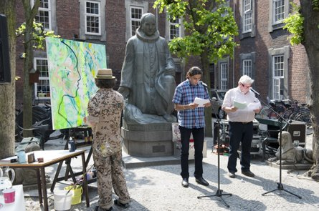
Interfolk at a glance
Interfolk is a non-profit organisation founded in 2008.
The mission is to examine and promote lifelong learning in civil society
The activities include surveys, pilot work, courses and events in a Danish, Nordic, and European context.
Last 15 years engaged in up to 30 international projects with support from
EU programmes like Erasmus+, Creative Europe, and Europe for Citizens, both to projects and training courses.
Nordic Baltic programmes, like Nordplus Adult and Nordic Culture Contact.
Nordic Council of Ministers’ support to NGO-cooperation in the Baltic Sea region.
Cultural project event in the yard of Vartov, Copenhagen

Slide 3
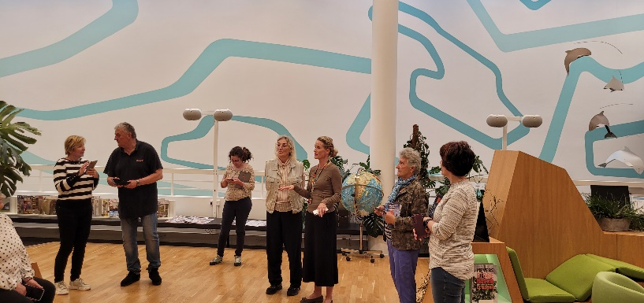
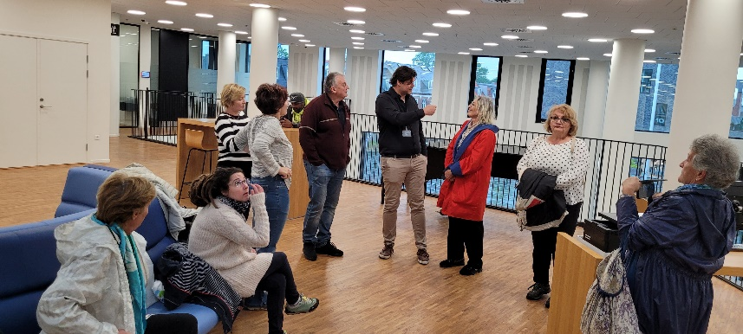
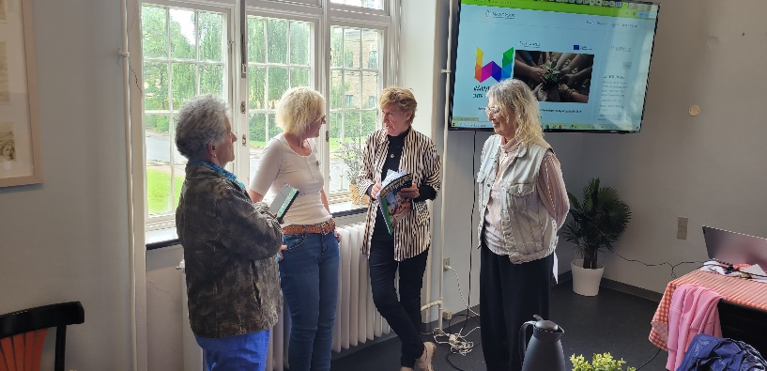
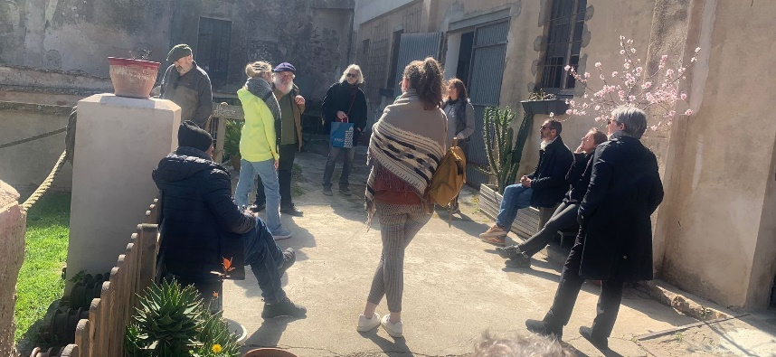
Micropolis – The Danish team
Two public organisations and two NGOs
Susanne Juhl Paaske, General Manager, Volunteer Centre Middelfart
Kamilla Krogh Uttrup, Culture Consultant, Culture Island
Henrik Louring, leader of Culture and Leisure, Middelfart Municipality
Hans Jørgen Vodsgaard, leader of Interfolk, Institute for Civil Society
Kamilla present activities at Culture Island
Henrik presents parts of the open Town Hall
Susanne gets a present from Hungarian group
Hans as coordinator for a Danish Erasmus+ visit to Palamos

Slide 4
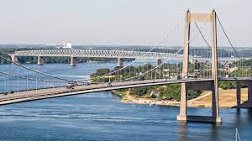
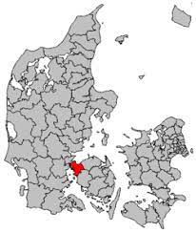
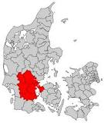
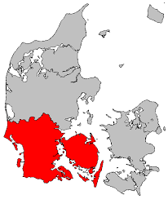
4
Middelfart Municipality
Located on Funen (1)
Two Bridges
Covers an area of 297 km²
Approx 41.000 inhabitants
Part of The Triangle Area (2)
Part of Region of Southern Denmark (3)
1
2
3

Slide 5
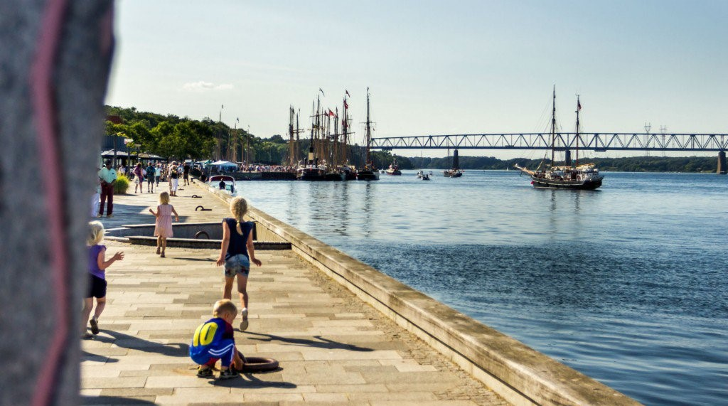
Strategy and political ambitions
5
Vision of the City Council 2030 - We built bridges:
Create active and healthy communities
Strengthening involvement / have a strong ”we”
Easier for citizens, associations and companies to take the initiative for activities that promote communities
Support associations, cultural players, and the unorganized and sometimes spontaneous cultural life
All citizens to feel pride
Cultural and leisure life must be
based in local communities

Slide 6
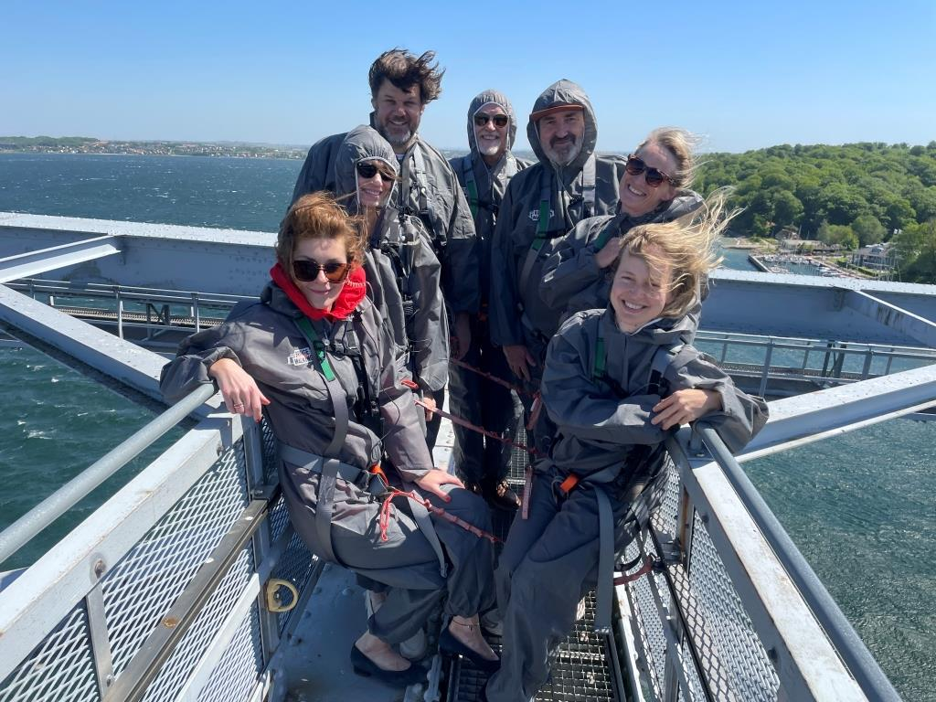
Micropolis – a unique and ambitious project
Micropolis is very ambitious project:
A holistic approach to a local community that in principle may involve most stakeholders in the area.
And thereby also a need for cross-sector cooperation and co-creation.
It has the extra dimension by including international cooperation
On the top - bridge walking during the third partner meeting in Middelfart

Slide 7
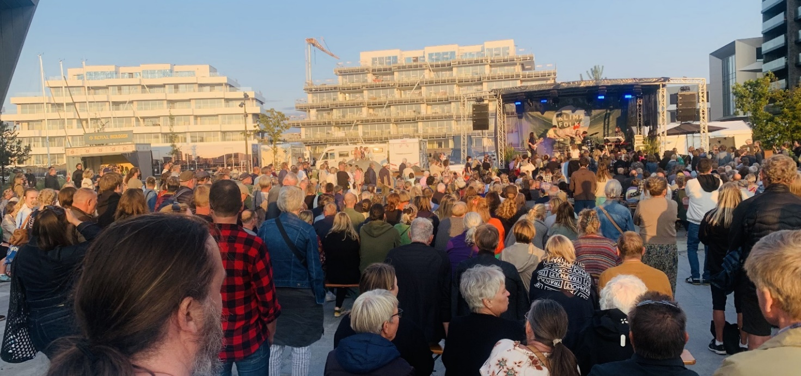
Micropolis – we needed to delimit the work
The holistic approach can in principle involve most stakeholders in the community.
It gives on the one hand many possibilities, but on the other hand some challenges for implementing the project – there was a need to delimit the initial need analysis and subsequent pilot work.
We limited the „key steps” to Micropolis by focusing:
on the social and cultural NGO activities.
on four added community values these activities may promote.
The main scene at the People’s Climate meeting, 2023

Slide 8
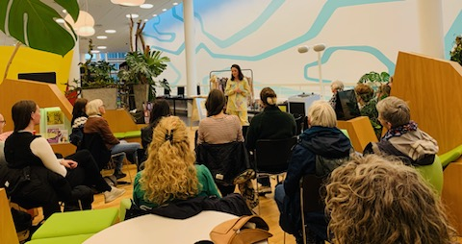
Micropolis – survey of added community values
The survey of the cultural and social organisations
focused on their ability to promote 4 types of added community values:
Local identity, connectedness to the area, community spirit
Social inclusion, openness, and diversity
Active citizenship and democratic values
Green values and environmental sustainability
The aim was
to clarify the status of the added community values (baseline), and
to disclose areas, where the local organisations could make improvements.
From workshop about sustainable clothes production at the Culture Island

Slide 9
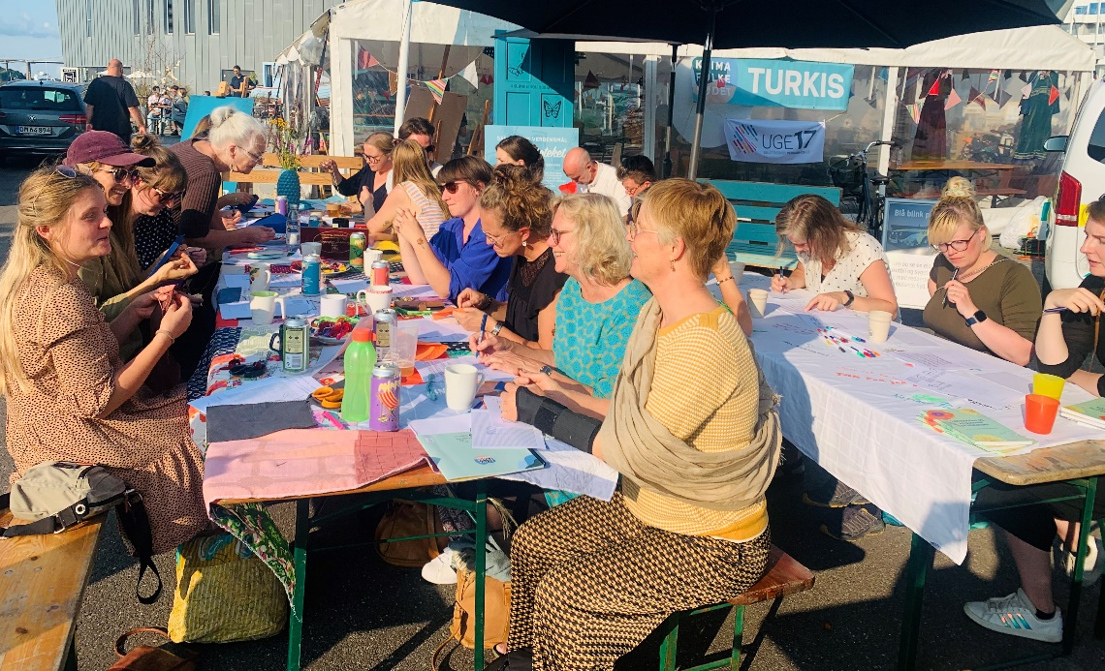
Micropolis – survey results
The green values and practises had a low score among the NGOs - even though it has a high priority in the official policies of the municipality.
The NGOs from different sectors did not have much cooperation - even though it can promote knowledge transfer, activity development, and improved communication to the wider community.
The associations had very little cooperation with peers in other parts of the country and in the other EU states – even though it can bring new inspiration and a wider outlook on the added community values of the activities.
Creative workshop during the People’s Climate Meeting 2023

Slide 10
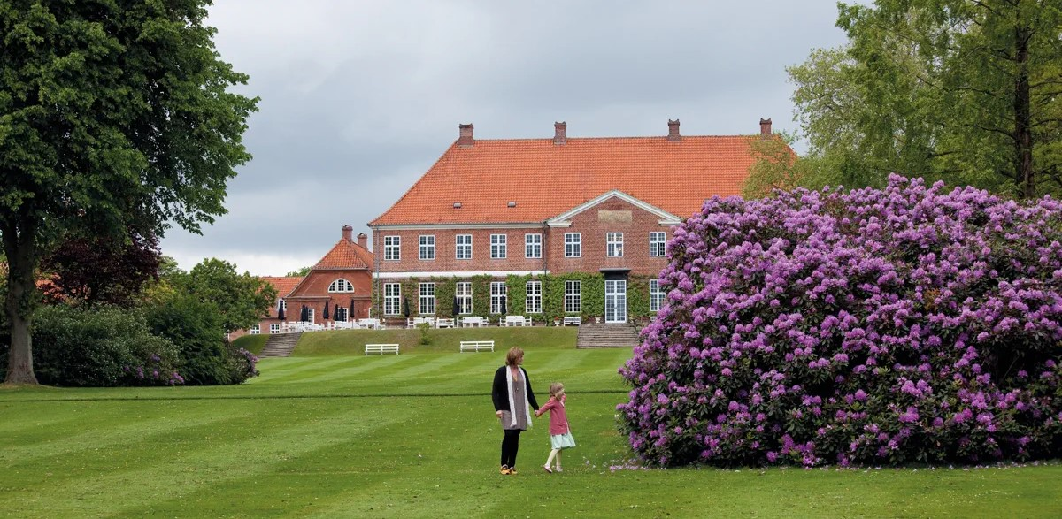
Micropolis – the implemented pilot work
New local courses and workshops that promote green aims and values.
Advice and initiatives to incorporate green values in social NGO activities.
Co-creation with stalls at the People’s Climate meeting in Middelfart.
New idea workshops for co-creation and networking between the cultural NGOs and the public culture institutions and Municipality’s culture unit.
New Erasmus+ mobilities so NGOs and staff from the municipality together can gain new knowledge and inspiration for co-creative activities.
Clarify how the holistic ESG-framework (Environment, Social, Governance), promoted by the EU Commission, can be transferred to NGOs QA-work
The garden at Hindsgavl Castle

Slide 11
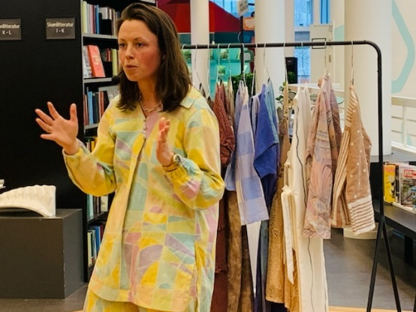
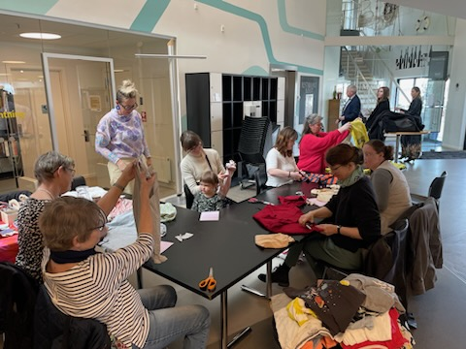
1st pilot – green workshops about reusing textiles
The global textile industry has a high climate footprint and is a main polluter.
The Volunteer Centre Middelfart completed in collaboration with Middelfart Culture
and Library two workshops:
The first workshop was about the clothing crisis, sewing and recycling.
By Stine Højland that in 2018 started the company ATTER - with a simple concept: to sew clothes from recycled materials.
The second workshop presented how old textiles can be made into new things.
Recycling designer Tina Amlund from UkendtFyn gave a lot of tips to upcycle everything, we find in the recycling shop or have at the back of the wardrobe.
Middelfart Culture and Library already hosts a Repair Café and hopefully
the work with textiles will become part of the Repair Café.

Slide 12
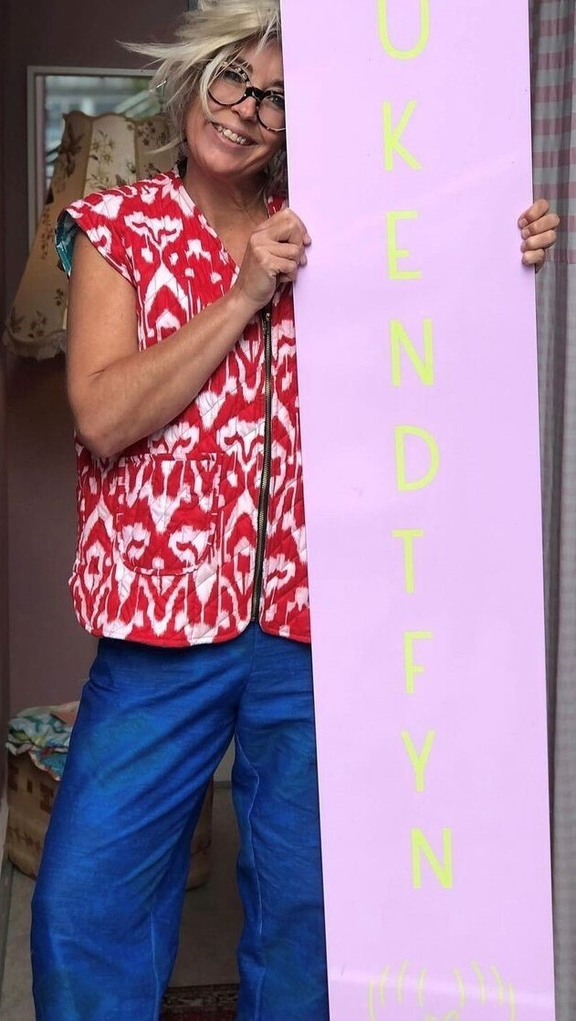
2nd pilot – green menu for social NGOs
The Volunteer Centres have, until recently, not paid much attention to the
environment and sustainability.
Therefore, Volunteer Centre Middelfart prepared a “green menu” on how
the associations can stepwise incorporate the topics into their daily work.
The menu contains a list of points for each of
these 5 headlines:
Choose foods wisely
Avoid food waste and unnecessary packaging
Sustainable procurement
Transportation
Waste as resources
Later, the plan is to offer the associations sparring
on how they can include aims about climate and
sustainability in their statutes.

Slide 13
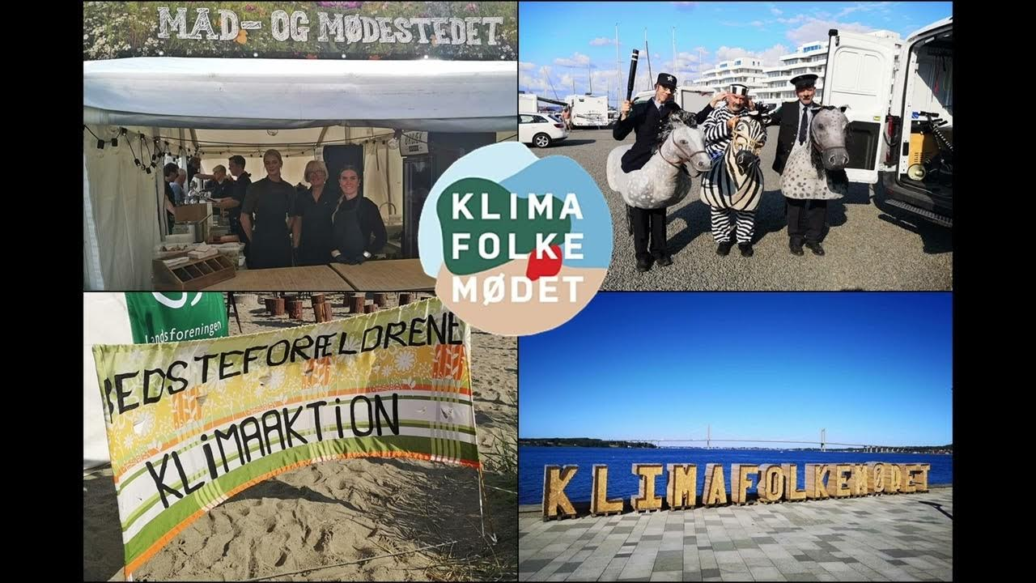
3rd pilot – stalls at Peoples Climate meeting
Volunteer Centre Middelfart planned together with a group of social voluntary associations and Middelfart Municipality to have activities in the yearly
People’s Climate meeting in Middelfart, august 2024.
See website for People’s Climate meeting, 2024, incl. link to short video about the event.
These co-creative activities included stalls, debate events, workshops on good green practice, and transport of visitors on cargo bikes, where they answered climate questions.
Stalls from the People’s Climate meeting, august 2023

Slide 14
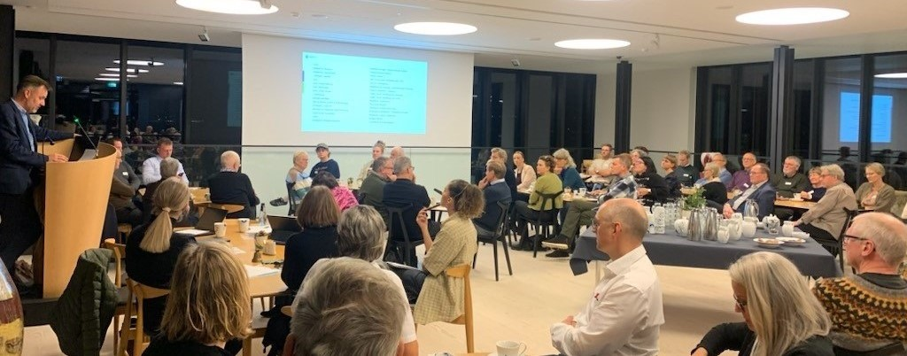
4th pilot – co-creative culture workshops
In November 2023, The Municipality’s Culture Department with inspiration from the Micropolis idea for the first time arranged a cultural idea workshop, where:
cultural NGOs, public cultural institutions, artist, and politicians from city council
were invited to an evening meeting at the Clay Museum with dining, presentations
and group work.
The aim was
to promote co-creation and networking between various cultural associations,
cultural entrepreneurs, the municipality, and the local politicians, and thereby
to strengthen local identity and cultural opportunities throughout the municipality.
Idea workshop for culture NGOs, culture institutions, local politicians and Municipality’s Culture Unit

Slide 15
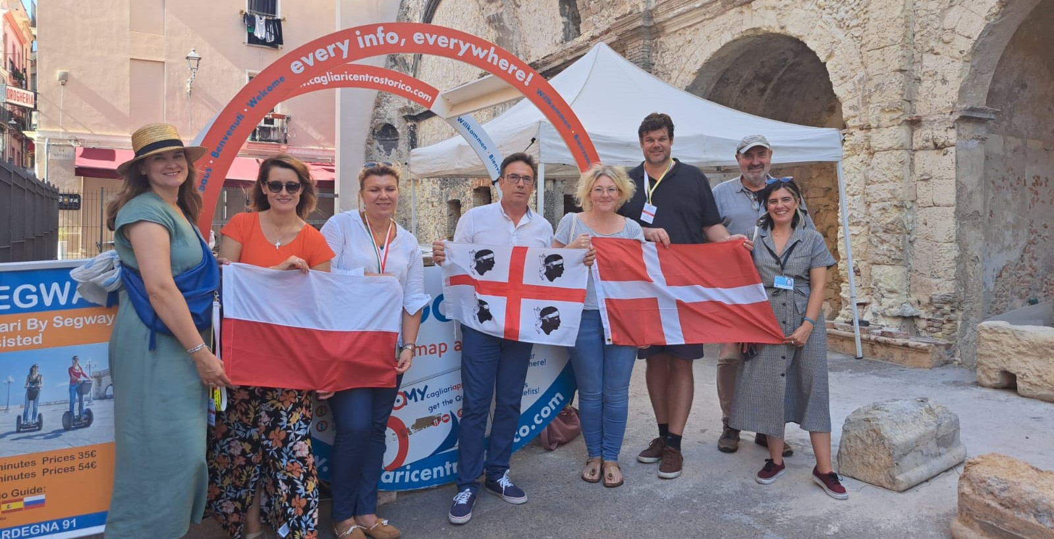
5th pilot – Erasmus+ mobilities
The Micropolis project shoved the value of international cooperation. The Culture
department applied for and got Erasmus+ mobilities to initiate this autumn.
The mobility plan for a mixed group of 30 NGOs and public servants
includes a series of courses to gain:
New competences to promote social inclusion and diversity in the associations.
More knowledge and skills to implement environmental sustainability.
Better digital competences for improving the communication and planning.
More recognition of the European dimension and international inspiration.
From the second partner meeting in Cagliari, Sardinia.

Slide 16
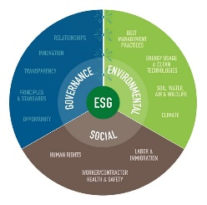
6th pilot – ESG methodology for NGOs
New EU legislation in 2023 implies bigger private and public organisations use the
ESG framework (Environment, Social, Governance) to report their activities.
This demand can soon include other types of organisations, including NGOs.
During the spring 2024 we examined how to adapt and transfer this holistic method
to NGOs as a new mean to plan, evaluate and report activities, including:
Environmental aims to reduce the climate footprint
Social aims to secure human rights, diversity, equality, and inclusion
Governance aims of democratic values, ethical conduct, and transparency.
Getting started with ESG seems like a big task,
but by taking small steps to implement it,
associations can gradually improve their
sustainability, reputation and success.

Slide 17
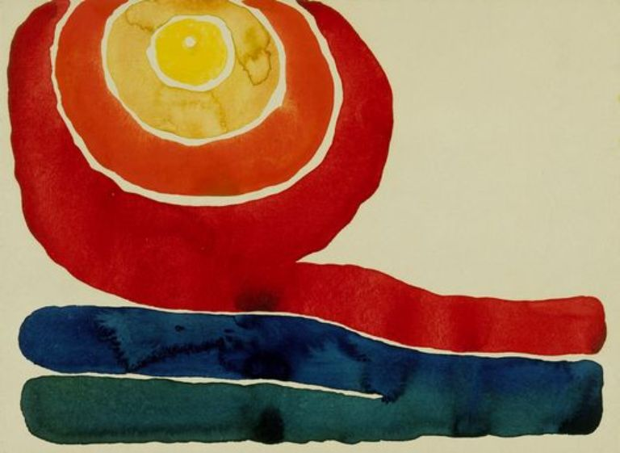
Concluding – learning points from the project
The Micropolis idea has a holistic approach with many possibilities,
Which you need to delimit to get a feasible plan. I can recommend:
Delimit both the initial need analysis and the subsequent pilot work – fx only engage few project actors and focus on few added community values.
When you know the baseline and have clear goals – then small adjustments of the core activities can improve the added community values.
Plan cross-sector cooperation and co-creation with other NGOs as well as public institutions and local authorities.
Include a wider national and even cross-national dimension – to bring new knowledge, inspiration and motivating.
For inspiration, see
the stepwise paths in the Guidebook!
Georgia O'Keeffe: Evening star iv, 1917

Slide 18
18
Thank you for the attention!

