Slide 1
IO4 / The MENTORING System Guidelines and scenario for the implementation of (e-)mentoring systems supporting international cooperation in the 3rd sector of adult learning organizations
EUROPEAN CONFERENCE: International cooperation. How to start it well?
22nd of September 2020
Presenter: Lorenza LUPINI, COOSS

Slide 2
AIM of Mentoring Report →
to deliver ready-to-use mentoring programmes, both for the adult education organisations managers and first-time international project managers.

Slide 3
REALISATION of Mentoring Report
Collection of guidelines and scenario
5 different partners countries
September 2019 – August 2020
Development of National Offer and Test
Report and Knowledge Pills

Slide 4
HOW can I use or gain benefits from the IO4/Mentoring System? How could it support my work? How could it be used and applied in my organization?

Slide 5
What is mentoring?
a. a work-based training intervention where mentor and mentee work one-on-one
b. face-to-face or also over other communication channels (e-mentoring)
c. based on trust
d. mentoring can be both a formal and informal process

Slide 6
Mentoring, not coaching
Mentoring differs from coaching in the following characteristics:
mentoring is a longer term relationship
mentoring has a wider focus, coaching focuses usually on specific issues
mentoring can include focus on personal and career development, while coaching is focused mainly on performance

Slide 7
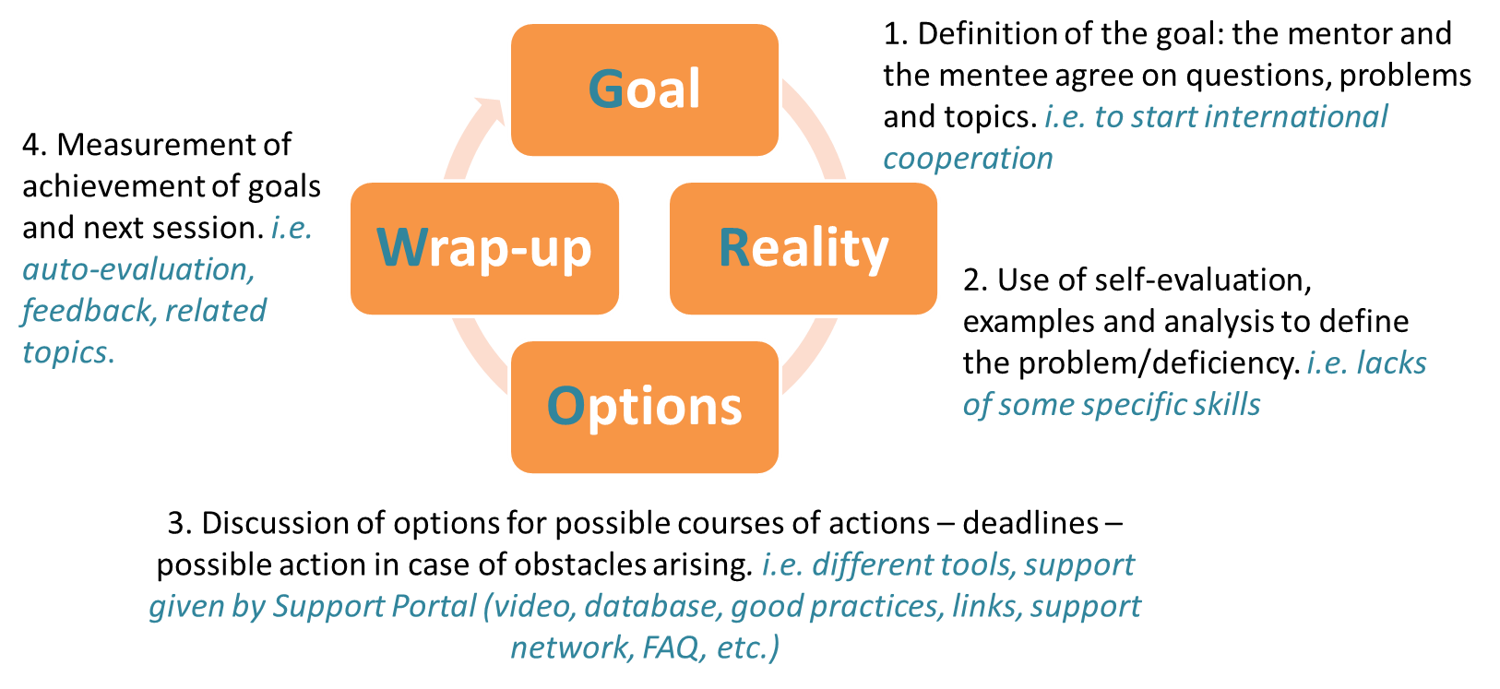
Preliminary Observations - 1
1) The mentoring activity usually consists of different and consequential sessions.
These sessions are planned according to the GROW cycle:

Slide 8
Preliminary Observations - 2
2) Balanced approach: asking questions or giving solutions?
MORE CONTROL
MORE POWER
Say what and how | Give an advice | DEMONSTRATE | Make proposals | Ask questions
To give solutions, proposals. i.e. database, links, tutorial
To give examples. i.e. good practices, knowledge pills
To stimulate. i.e. FAQ, related topics

Slide 9
Preliminary Observations - 3
3) To have in mind the importance of constructive feedback:
to build trust between the mentor and the mentee

Slide 10
How could it support my work?
The practice of MENTORING is extremely useful and used to share the experience from more experienced to unexperienced people/employees and enhance the most the know-how.
Thanks to an effective mentoring, the mentor can
teach all its knowledge and experience to their "pupil" or "mentee" and promote their inclusion, professional growth and personal maturation.

Slide 11
How could it be used and applied in my organization?
Here a list of Practical GUIDELINES and RECOMMENDATIONS and for an affective Mentoring in 3rd sector organization of adult education

Slide 12
Practical GUIDELINES
Application Form (Expression of interest)
Procedure for getting a mentoring offer, including initial replies and contacts
Mentoring Agreement to sign
Set of queries:
1. needs assessment of the mentee’s competence profile and needs for improvement
2. query for outlining the organisation’s international development plan
3. final queries to assess efficacy of process
A list of communication tools
The follow-up session

Slide 13
RECOMMENDATION
1. To clarify and share the aims of the mentoring process at the beginning of the process
2. To define a set of standard procedures to access in a mentoring project (i.e. need assessment, initial and final evaluation and self-evaluation, minimum of hours, etc.)
3. To set adequate number of mentors and hours per mentees: balanced resources
4. To clarify the role of the mentor and what kind of support he/she can provide to the mentee
5. To set a clear agreement on scheduling (agenda, duration, deadline, etc.)
6. To deepen the knowledge of the CSO context and the specific needs for accessing the international funds

Slide 15
Thank you for your attention!
Lorenza Lupini
l.lupini@cooss.marche.it
COOSS - Italy

