Slide 1
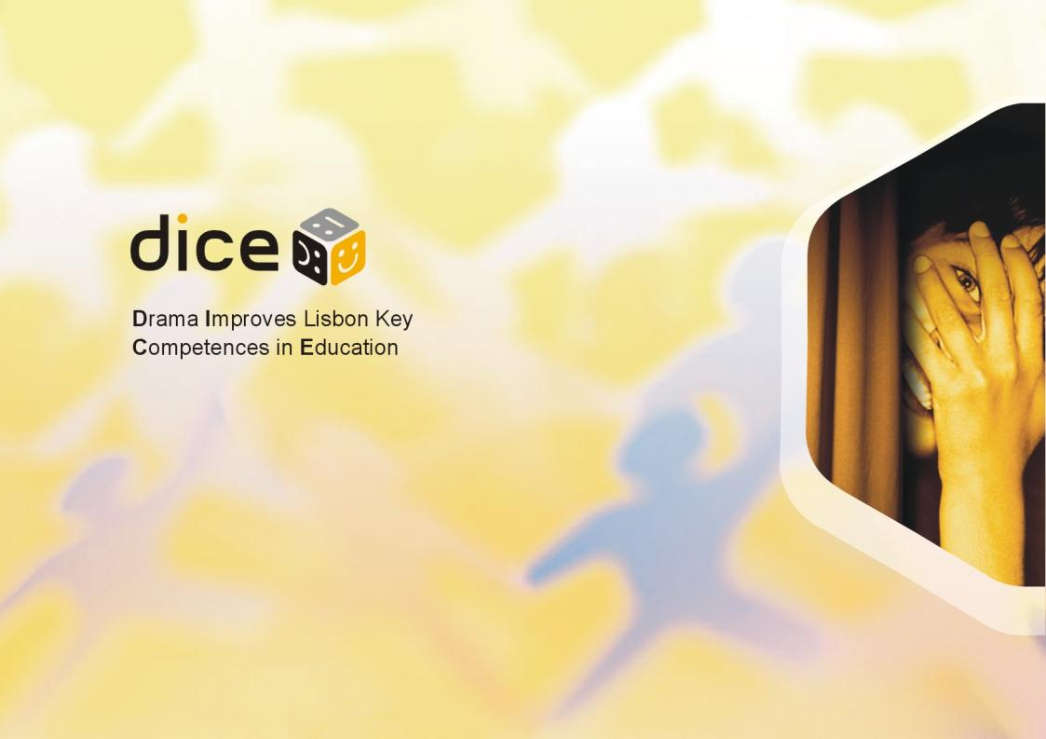
DICE conference
25th October
European Parliament, Brussels

Slide 2
What is DICE? - introduction of the project and the Policy Paper
Ádám Cziboly
DICE project leader

Slide 3
What is the DICE project?
international
EU-supported
two-years-long
cross-cultural research
effects of dramatic activities
on Lisbon Key Competences
  Communication in the mother tongue
  Learning to learn
  Interpersonal, intercultural and social competences, civic competence
  Entrepreneurship
  Cultural expression

Slide 4
The consortium
Consortium leader:
Hungary: Káva Theatre in Education Company (Káva Kulturális Mûhely)
Consortium members:
Netherlands: Foundation Leesmij
Poland: University of Gdansk (Uniwersytet Gdanski)
Romania: Sigma Art Foundation (Fundatia Culturala Pentru Tineret Sigma Art)
Slovenia: Taka Tuka Club (Durštvo Taka Tuka)
United Kingdom: Big Brum Theatre in Education Co. Ltd.
Associate partners:
Czech Republic: Charles University, Prague
Norway: Bergen University College (Hogskolen i Bergen)
Palestine: Theatre Day Productions
Portugal: Technical University of Lisbon (Universidade Técnica de Lisboa)
Serbia: Center for Drama in Education and Art CEDEUM (Centar za dramu u edukaciji i umetnosti)
Sweden: Culture Centre for Children and Youth in Umea (Kulturcentrum för barn och unga)

Slide 5
The database
data from 4,475 students altogether : 12 countries, 111 drama programmes and their control groups
1 080 different variables were measured per student
exactly 4,833,000 cells of unique data
several hundred thousands of connections, interactions and relationships to be examined among variables
a statistical output file of 1,23 GB (just the very first and basic analyses only)
the potential for several dozen publications in the coming years
… we have a goldmine or „a DNA sample” or educational theatre and drama
At this stage we focus on the most important key results

Slide 6
Key results – relevance for educational practice and policy
compared with peers who had not been participating in any educational theatre and drama programmes, the theatre and drama participants
are assessed more highly by their teachers in all aspects,
feel more confident in reading and understanding tasks,
feel more confident in communication,
are more likely to feel that they are creative,
like going to school more,
enjoy school activities more,
are better at problem solving,
are better at coping with stress,

Slide 7
9. are very significantly more tolerant towards both minorities and foreigners,
10. are much more active citizens,
11. show more interest in voting at any level,
12. show more interest in participating in public issues,
13. are more empathic: they have concern for others,
14. are more able to change their perspective,
15. are more innovative and entrepreneurial,
16. show more dedication towards their future and have more plans,
17. are much more willing to participate in any genre of arts and culture, and not just performing arts, but also writing, making music, films, handicrafts, and attending all sorts of arts and cultural activities,

Slide 8
18. spend more time in school, more time reading, doing housework, playing, talking, and spend more time with family members and taking care of younger brothers and sisters. In contrast, they spend less time watching TV, surfing on the internet or playing computer games,
19. do more for their families, are more likely to have a part-time job and spend more time being creative either alone or in a group. They more frequently go to the theatre, exhibitions and museums, and the cinema, and go hiking and biking more often,
20. are more likely to be a central character in the class,
21. have a better sense of humour,
22. feel better at home.

Slide 9
Relevance of the DICE project
Attila Varga
senior researcher, Hungarian Institute for Educational Research and Development

Slide 10
Relevance
Comparison with other large-scale competence assessment programmes:
DICE is an effort to prove that it is possible to develop methodology for monitoring ALL Lisbon competences
  Collecting data about competences rarely examined before
  Much more complex source of data
Comparison with researches on the field of educational theatre and drama
  Very few quantitative measurements
  To our best knowledge the largest sample, the most complex design in the world so far
Educational and cultural policies
  Many synergies – Educational Theatre and Drama fits into more dozens EU documents see: DICE Policy Papar pp 21-26.

Slide 11
Main aspects of the research methodology
Ildikó Danis and Szilvia Németh
leaders of DICE research

Slide 12
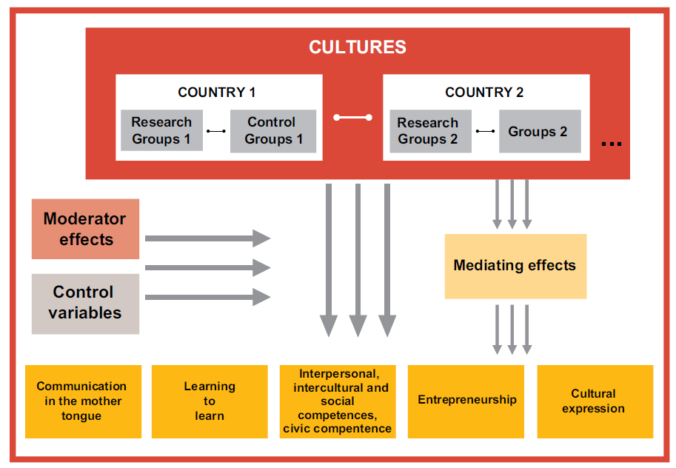
DICE Policy
Paper page 27.
Notes:
This project was the first one which tried to demonstrate statistically valid and reliable results from the field of dramatic activities in education on such a wide multicultural population. We suggested a longitudinal cross-cultural research study as a “skeleton” of the project, along with individual researches in all countries.
2. Data was collected from ‘educational fields’ of twelve nations.
3. Two different kinds of groups with different treatments was examined in every culture: Research groups and control groups. Research groups had two types:
Research groups with ‘one occasion’ drama: in which effects of drama as a special few-hours-long occasion (e.g. Theatre in Education) was measured,
Research groups with ‘continuous, regular dramatic activities’ : in which effects of regular meetings in a 3-4-month-long period (e.g. youth groups preparing theatre performances) was investigated (a minimum for continuous activity was 10 occasions/meetings),
There were Control groups for both research groups: in which there were no occurrences of dramatic activities in education.
4. Our main purpose was to examine the effects of drama activities on 5 Lisbon competences, which were the following: …..
5. We assumed that dramatic activities can affect the investigated Key Competences positively, but the results may depend on some other variables as well, like:
cultural background of education: e.g Demography of child’s family: education of the parents, reading in family, are you poor/rich, Support etc.
the type of dramatic activity used: e.g. Frequency of the meetings, length of the meetings, how long the programme has been going on, other key characteristics of the dramatic activities
the sex or age of the children.
We called these ‘moderator variables’ because some effects can influence the results through these factors. For example: girls might be more sensitive than boys to dramatic education affecting empathy but not democratic attitudes, etc.
6. We can assume that drama not always affect in a direct way. Sometimes mediating factors can be hypothesized, such as….
E.g. Psychological well-being (or anxiety) in school and at home, Child characteristics: Feeling control, Feeling development, Self-respect, Challenge, Flexibility, Social situation in class, Social anxiety, Self-esteem etc.
6. Some factors will be IMPORTANT in the close future in order to clean our results from some specific effects of some external things like intellectual capacity, length of time between input and output data collection or e.g. exams around the data-collections…

Slide 13
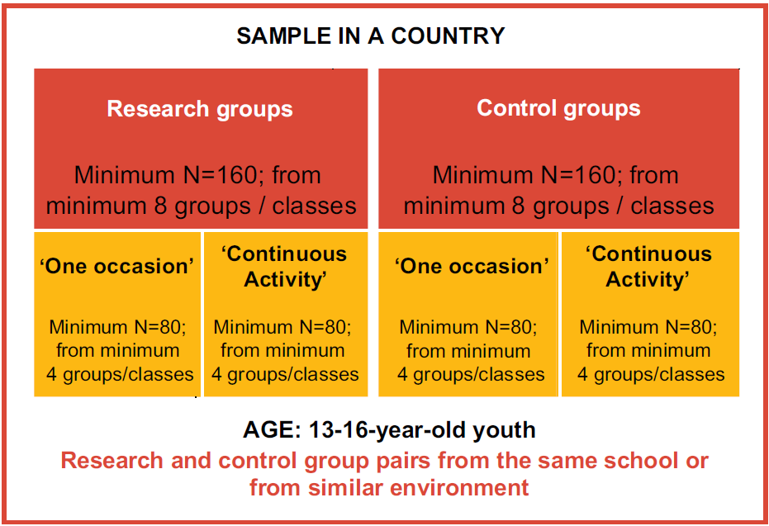
DICE Policy
Paper page 28.
Notes:
So every culture examined different kind of research groups and their controls. It was important for the data collection: that the groups had to attend the same school or belong to a very similar environment as the research ones. Checking the demographical variables of the research and the control groups, we can say that ther ie no significant diffenrences according to these factors.
Finally we had 111 different drama programmes and their controls, 4475 children in our study.
13-16-year-old youth were investigated in the research study. We have chosen an adolescent cohort to investigate, because: (1) the definition of key competences is a suggestion for output and therefore a „guide” for education: older children are closer to this output, (2) one of the aims of education is to prepare for life: this can be measured among older children only, (3) competences developed in younger ages could easily be destroyed by later (mis)education, (4) drama activities in education are usually used in adolescence because teachers believe that developing competences, attitudes and skills are very effective in that age group, (5) reliable measurement of attitudes is more possible in that age group (e.g. questionnaires are not reliable with little children).

Slide 14
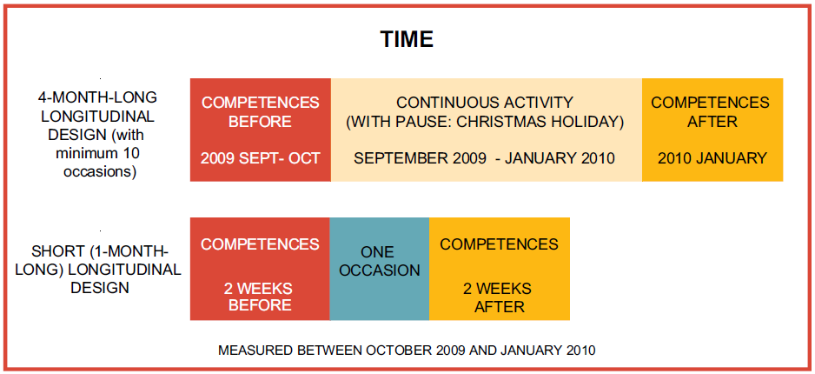
DICE Policy
Paper page 28.
Notes:
Two longitudinal investigations was conducted to demonstrate some robust effects of dramatic activities on key competences:
a 4-month-long design for continuous and a short-time (1-month-long) design for one occasion activities
Data collection point were between Sept of 2009 and Jan of 2010.

Slide 15
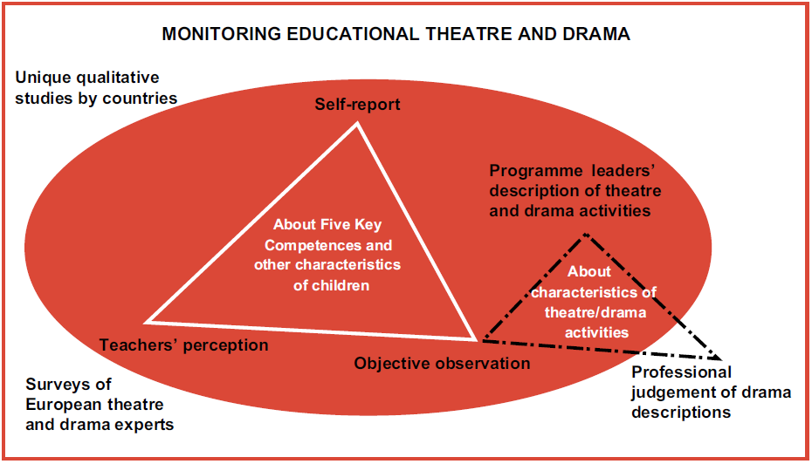
DICE Policy
Paper page 30.
Notes:
We gathered a lots of information from several perception:
1. Questionnaire for students: a 14-page-long set of self-completed questions about the key competences and some background variables (self-reported component of our research). We collected both input and output data. The questionnaire measured a wide variety of aspects of all the competences:
Communication in the mother tongue
Learning to learn
Interpersonal, intercultural and social competences, civic competence
Entrepreneurship
Cultural expression
Mediator variables
Moderator variables
2. Questionnaire about each student for teachers of the classes
3. Structured observation of educational theatre and drama activity
4. Structured description by each programme leader about their educational theatre and drama activities
5. Independent (“blind”) professional pre-classification of the programmes
6. Structured survey from the project leaders and other European theatre and drama leaders about the situation of educational theatre and drama in their countries
7. Different qualitative research studies conducted independently by the country partners
8. Secondary research

Slide 16
Introduction of the Educational Resource
Chris Cooper
editor of the Educational Resource

Slide 17
A- Introduction
The DICE Project - What is DICE? The project outlined
The DICE Project - Consortium members and partner organisations
Research Findings - Brief summary of key findings
Educational Theatre and Drama - What is it?
The DICE Project - Our ethos

Slide 18
B - How educational theatre and drama improves key competences
DOCUMENTED PRACTICE – 12 examples of Educational Theatre and Drama from: Gaza, Hungary, Netherlands, Norway, Poland, Romania, Serbia, UK.
Two DOCUMENTED PRACTICES per competence:
  Learning to learn
  Cultural expression
  Communication in the mother tongue
  Entrepreneurship
  Interpersonal, intercultural and social
  competences, civic competence
  And a sixth created by the DICE partners
All this and more….

Slide 19
C - Another throw of the DICE – What you can do
Developing the use of educational theatre and drama
Six simple steps designed for:
teachers
head teachers
artists
students
university lecturers and teacher trainers
policy makers.

Slide 20
D - Appendices
A - Terminology – Some theatre and drama terms explained
B - Finding out more - Where to find more information:
Bibliography, web addresses, contacts, courses.
C - Contacting the Consortium

Slide 21
Effect of educational theatre and drama on entrepreneurship, innovation and creativity
Results presented by Ildikó Danis,
DICE researcher

Slide 22
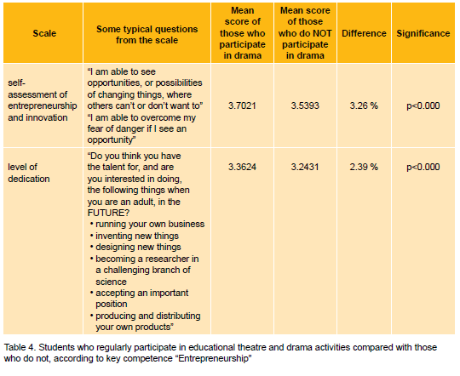
Effects on entrepreneurship and dedication
DICE Policy Paper page 46.
Notes:
According to the entrepreneurship and dedication scales there were significant differences again between students who regularly participated in drama activities and those who do not.
According to the children’s self-perception: those who participated regularly drama, reached better scores on self-assessment of entrepreneurship and innovation and on level of dedication.

Slide 23
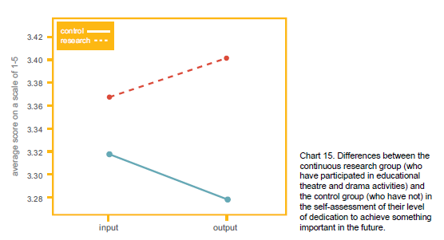
Effects on dedication
DICE Policy Paper page 47.
Notes:
In this graph you can see that in this little period (around 3 month) there were also minor, but positive shifts for the research groups in the self-assessment of their level of dedication to achive something important in the future.

Slide 24

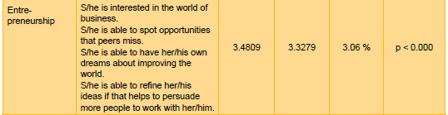
Teachers about the children
DICE Policy Paper page 53.
Notes:
Just at the same way, the teachers perceived the research groups more positively in the entrepreneurship scale after the DICE research period.

Slide 25
Round table discussion
Moderator: Karolina Rzepecka, University of Gdansk, DICE national coordinator Poland
Adam Jagiełło Rusilowski presents Documented Practice: A bunch meaning business: an Entrepreneurial Education programme, University of Gdansk and POMOST, Poland; and the Qualitative research: Mantle of the Expert technique for teaching entrepreneurship at the University of Gdansk
Ljubica Beljanski Ristic presents Documented Practice: Early Sorrows – drama workshop, CEDEUM, Serbia
Filippo Addarii, Executive Director, EUCLID Network, reflects on the discussion

Slide 26
Adam Jagiello-Rusilowski
Institute of Education
University of Gdansk, Poland

Slide 27

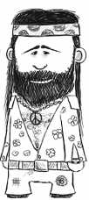
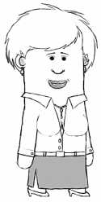
Example questions to „bots”
Since you are a chemist you should not be hyper or absent-minded. But perhaps this is the sign of your creativity? What if it annoys other workers>?How would you deal with their negative attituted towards you.
You seem to be well focused on your personal goals. Working with utilisation of used cooking oil to what exent would you be willing to take risks?
Which foreign languages do you speak?

Slide 28
Ljubica Beljanski Ristic
CEDEUM, Serbia

Slide 29
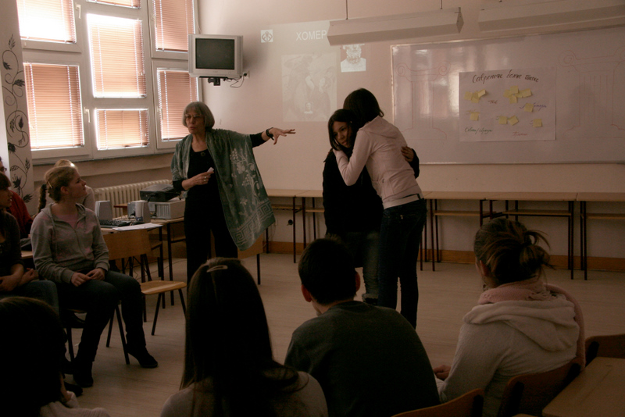
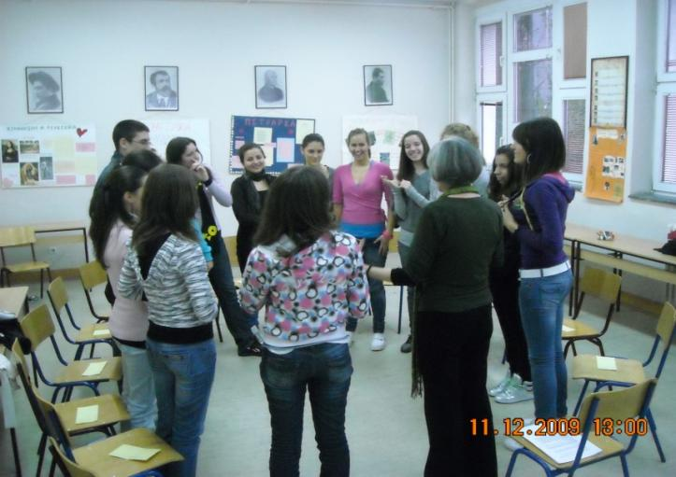

Early Sorrows – Drama Workshop
CEDEUM, Serbia
The drama workshop Early Sorrows was one of the sessions of the Towards the Possible project created for the Serbian research within the framework of the DICE project.
The workshop was based on the regular school curriculum for the subject mother tongue and literature, and it meets the curricular requirements for the lesson, making them vivid through drama structures and updating them by establishing a relationship between them and personal stories and experiences of the students.
The workshop processes the book of short stories, Early Sorrows - For Children and Sensitive Readers, by Danilo Kiš, and one story, The Wild Chestnuts Street, in particular.
The workshop lasted for 45 minutes, which is the duration of a regular school class.

Slide 30
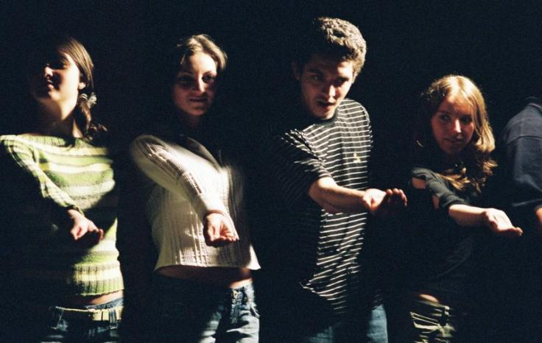




Entrepreneurship
This workshop contributed to the competence related to Entrepreneurship, because we managed to turn ideas into action, as well as the implementation of an imaginary idea in a real, planned public campaign.
The design and realization of the project is the result of a mutual effort by the CEDEUM team in collaboration with the High School for Pharmacy and Physiotherapy in Belgrade
Workshop leader: Ljubica Beljanski-Ristić, CEDEUM
and Cultural Institution “Parobrod”
Observers: Anđelija Jočić, Marjam Ristić, Angelina Stanojević, CEDEUM
Assistants: Jelena Stojsavljević, Ivana Pantić and Biljana Petrović, teachers of mother tongue and literature at the school

Slide 31


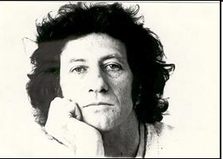
Early Sorrows
For Children and Sensitive Readers
Danilo Kiš said that he accepted difficult situations and hardships as a challenge and a spiritual game. The book Early Sorrows - For Children and Sensitive Readers is about his memories of childhood, and the writer tells the reader that he himself isn’t sure what in the book comes from real life, and what is the result of his imagination, because it is all interwoven. Danilo Kiš is a writer of vast energy and erudition, of richly layered cultural, historical and linguistic heritage seamlessly woven into powerful human drama.
Kis, Danilo (1998) Early Sorrows,
For Children and Sensitive Readers,
English translation by Michael Henry Heim,
New direction Books USA, or Penguin Canada

Slide 32
Effect of educational theatre and drama on communication skills and learning to learn
Results presented by Ildikó Danis,
DICE researcher

Slide 33
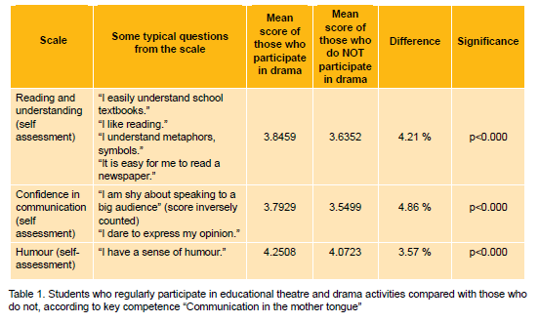
Effects on communication
DICE Policy Paper page 37.
Notes:
According to the communication scales there were significant differences between students who regularly participated in drama activities and those who do not.
According to the children’s self-perception: those who participated regularly drama, reached better scores on reading and understanding scale, on confidence in communication scale and humour scale.

Slide 34
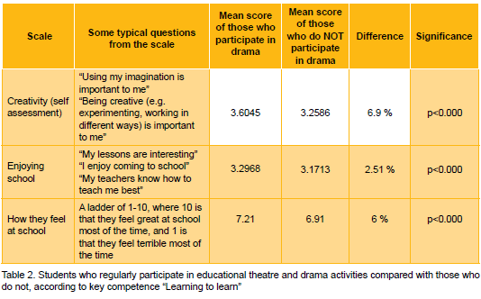
Effects on learning to learn
DICE Policy Paper page 39.
Notes:
According to the learning to learn scales there were significant differences again between students who regularly participated in drama activities and those who do not.
According to the children’s self-perception: those who participated regularly drama, reached better scores on creativity in learning scale, on enjoying school scale and a 10-grade Likert-item called how you feel at school.

Slide 35
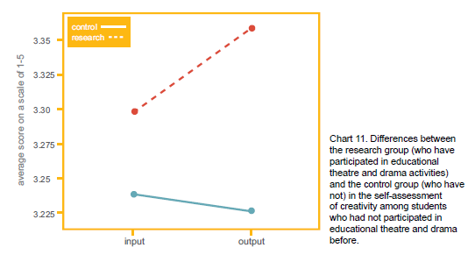
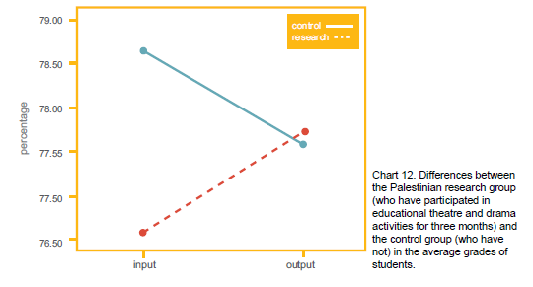
Effects on creativity in learning
Effects on average grades in Palestine
DICE Policy Paper page 39.
Notes:
In this two graphs you can see that in this little period (around 3 month) there were also minor, but positive shifts for the research groups.
- e.g. The perception of creativity in learning increased
- And the Palestine research groups moved in the opposite way with their average grades, then the controll groups

Slide 36
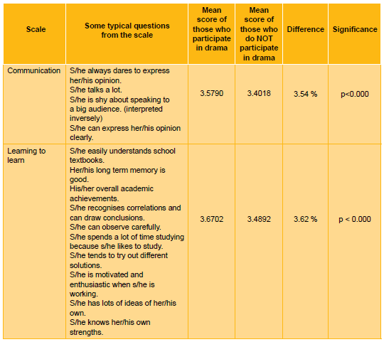
Teachers about the children
DICE Policy Paper page 52.
Notes:
Just at the same way, the teachers perceived the research groups more positively in the communication and learning to learn scale after the DICE research period.

Slide 37
Round table discussion
Moderator: Jane Woddis, DICE national researcher, United Kingdom
Chris Cooper presents Documented Practice: Suitcase – drama workshop, Big Brum Theatre in Education Company
Krisztina Mikó presents Documented Practice: Obstacle Race – theatre in education programme, Kava Drama/Theatre in Education Association, Hungary
Jean-Claude Berutti, president, European Theatre Convention, presents ETC’s project “Young Europe – Young Creation and Education in Theatre”

Slide 38
Chris Cooper
Big Brum Theatre in Education Company
Birmingham, UK

Slide 39
Krisztina Mikó
Kava Drama/Theatre in Education Association
Budapest, Hungary

Slide 40
Effect of educational theatre and drama on social competences and active citizenship
Results presented by Attila Varga,
DICE researcher

Slide 41
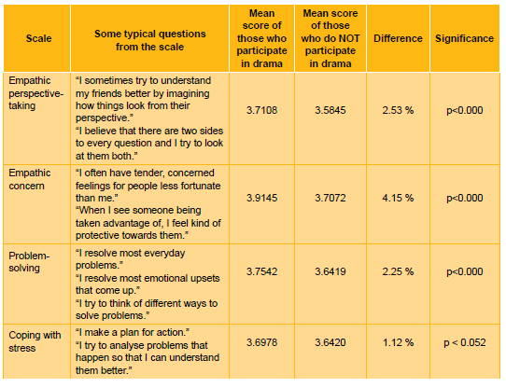
Effects on social competence
DICE Policy Paper page 42.

Slide 42
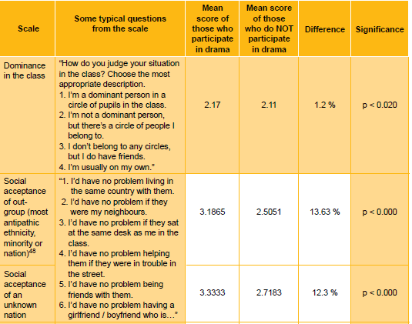
DICE Policy
Paper page 43.

Slide 43
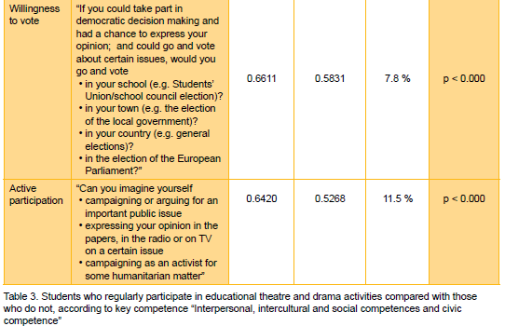
DICE Policy Paper page 43.

Slide 44
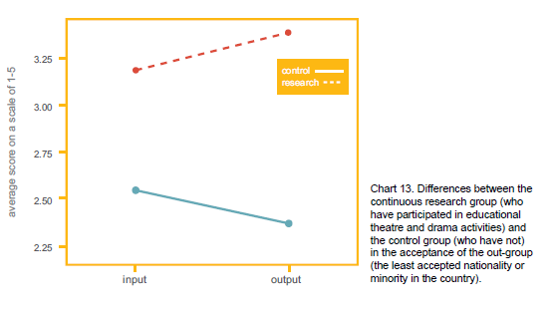
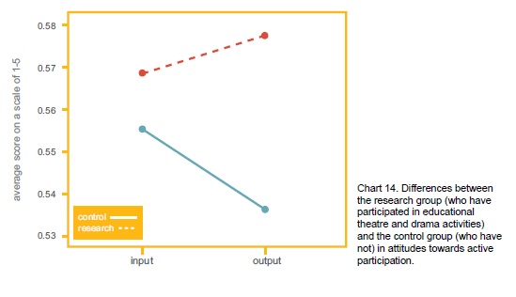
Effects on
social acceptance
Effects on
active participation
DICE Policy Paper page 44-45.

Slide 45
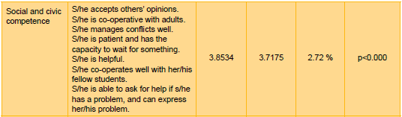
Teachers about the children
DICE Policy Paper page 53.

Slide 46
Round table discussion
Moderator: Suzanne Prak, Stichting Leesmij, Wageningen
Sietse Sterrenburg presents Documented Practice: The Stolen Exam – Leesmij, Netherlands
Irina Pilos presents Documented Practice: The Teacher – Theatre in education programme, Sigma Art, Romania
Anne van Otterloo, consultant, Annalin, cultuur en innovatie, reflects on the discussion

Slide 47
Sietse Sterrenburg
Leesmij, Netherlands

Slide 48

The Stolen Exam

Slide 49
Irina Pilos
Sigma Art, Romania

Slide 50

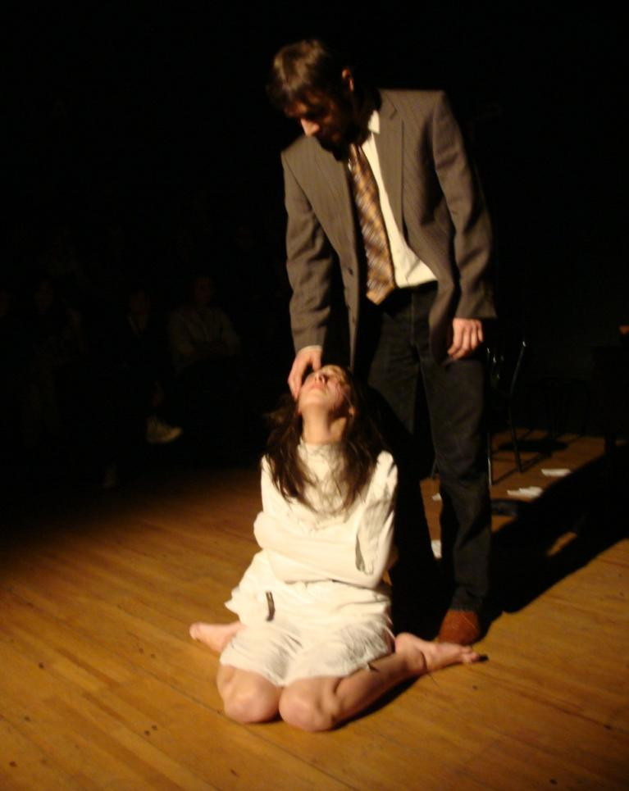
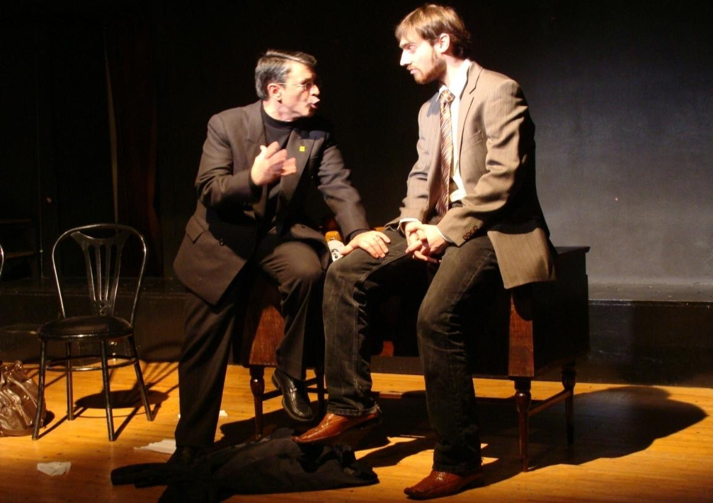
Sigma Art Romania
The TEACHER for Youngsters and Teachers at ACT Independent Theater in Bucharest

Slide 51
The essential message of “The Teacher” as a dice fundamental educational and social action
The Teacher presents, in specific detail, the relationship
between teacher and student, the relationship between that
same teacher and a parent of a usual student “with problems”;
also the relationship between teacher with his own daughter -
who is following in her original way his footsteps in taking over
the school as a literature teacher.
This is the crucial moment for the TIE programme as a DICE
authentic example: the girl is discovering, due to her
“massive” theatre education, that the only chance to establish
a real communication and educational evolution for the
nowadays youngsters is the use of Drama and Theatre in
Education as an active educational tool.

Slide 52
Effect of educational theatre and drama on cultural awareness and intercultural values
Results presented by Szilvia Németh, DICE researcher

Slide 53
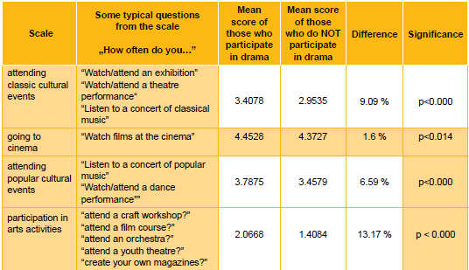
Effects on cultural activities
DICE Policy Paper page 48.

Slide 54
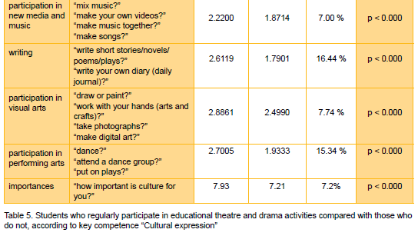
DICE Policy Paper page 48.

Slide 55
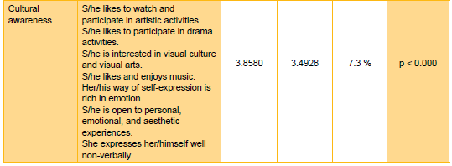
Teachers about the children
DICE Policy Paper page 53.

Slide 56
Round table discussion
Moderator: Jane Woddis, DICE national research leader, United Kingdom
Katrine Heggstad presents Documented Practice: Seeking Survival – drama workshop, Eventus TIE, Norway
Jan Willems presents Documented Practice: Kids for Kids - The Magic Grater, Theatre Day Productions, Gaza, Palestine
Leonor Wiesner, Policy Officer - Culture - competition policy and synergies with Education, DG EAC, presents the Open Method Coordination and the working group “Stronger synergies between culture and education” and the relations of cultural awareness competence and the Europe 2020 strategy

Slide 57
Katrine Heggstad
Eventus TIE, Norway

Slide 58
Jan Willems
Theatre Day Productions, Gaza, Palestine

Slide 59
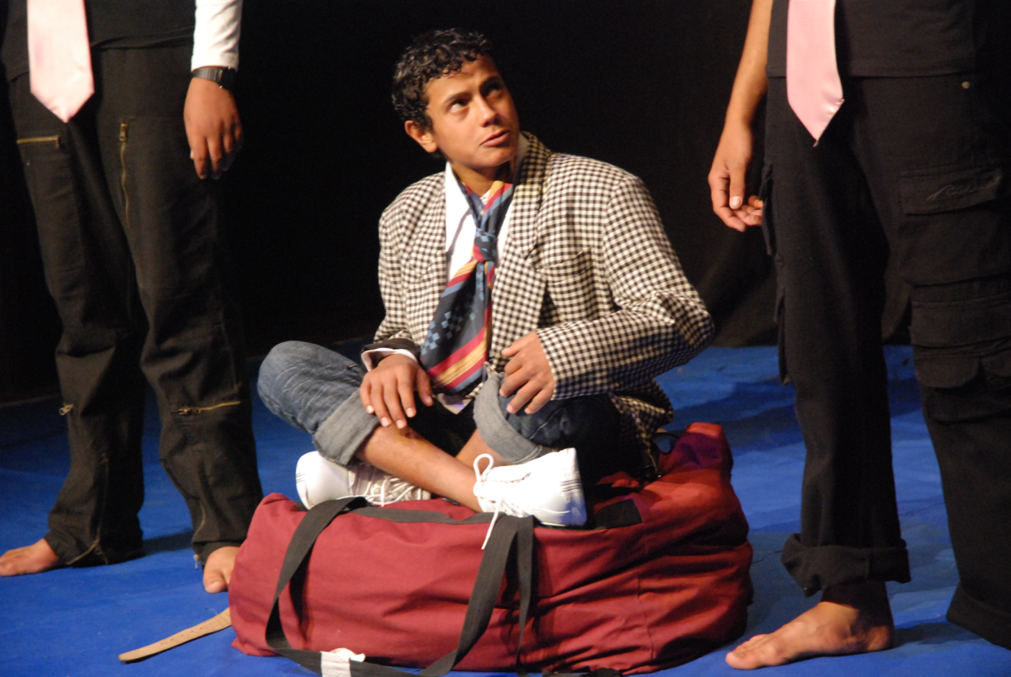
Bag and Doctor

Slide 60
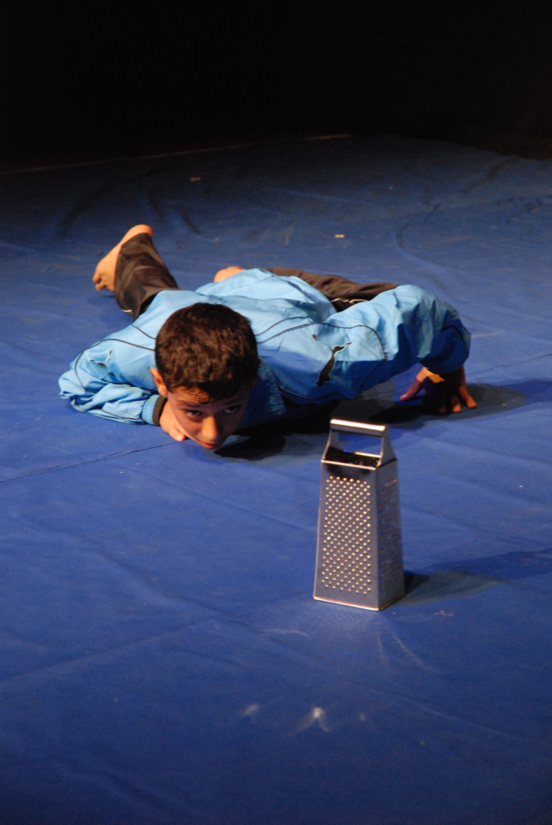
Boy and Grater

Slide 61
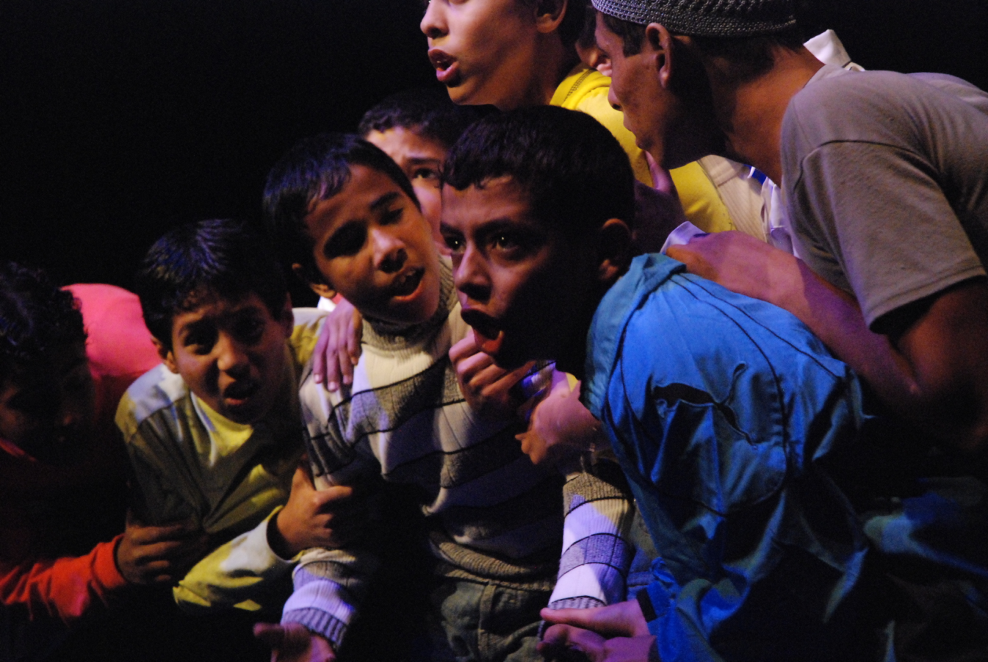
Group intro Play

Slide 62
Educational theatre and drama and the European educational systems
Results presented by Szilvia Németh,
DICE researcher

Slide 63
1. Drama-experts’ survey
Aim of the survey
to share thoughts;
to assess the situation of educational drama in the countries of respondents.
Method: an online survey on the project’s website
Participation was open to drama experts interested in filling in the questionnaire.

Slide 64
Number and country of drama experts participating in the survey
Country | Number of respondent experts
Czech Republic | 2
Netherlands | 2
Norway | 10
Palestine | 1
Poland | 1
Slovenia | 1
Hungary | 13
Serbia | 17
Sweden | 2
United Kingdom | 4
Romania | 2
Country | Number of respondent experts
Finland | 2
Croatia | 2
France | 2
Total | 61

Slide 65
Analysed topics and questions
Educational drama and theatre & teachers:
What kind of prestige do drama educators have among teachers in your country?
Educational drama and theatre & educational policy:
What supports the work and expansion of educational drama and theatre in your country?
What obstructs the work and expansion of educational drama and theatre in your country?
How does your country’s national, central curriculum (if it exists) fit the purposes of educational drama and theatre?
How could education policy help educational drama and theatre?
How could municipalities in your country help the development of educational drama and theatre?
How could national education policy in your country help the development of educational drama and theatre?
How could the EU help the development of educational drama and theatre?

Slide 66
Prestige of drama educators and educational drama in society
Rather positive | Positive/Negative | Rather negative
Poland | Netherlands | Czech Republic
Romania | Palestine | Hungary
Finland | Serbia | Norway
 | Sweden | Slovenia
 | United Kingdom | France
 | Croatia

Slide 67
Explanatory factors
Rather positive: educational drama used as an innovatove tool, popular among youngsters
Positive/negative: it is not taken seriously by public but usage and respect growing steadily at schools
Rather negative: educational drama is mostly looked at as entertainment, drama pedagogues are often not regarded as ‘real’ teachers, but as entertainers

Slide 68
The supportive and obstructive factors in the work and expansion of educational drama
Supportive factors – in general:
inner motivation, personal skills, conviction;
enthusiastic work, individual initiative;
supportive, experienced and dedicated teachers and senior management in schools,;
theatre and drama pedagogues, teachers and senior lecturers in higher education;
Master of Arts courses at recognised universities, regular courses in teachers’ training, departments specialised in educational theatre and drama, quality teaching materials;
work of NGOs, civil associations, theatre companies, national theatre and drama associations;
supportive theatres, arts centres, arts councils;
state financial subsidies, private sponsorship, national/international project money;
annual educational theatre and drama festivals, expert workshops, special publications, presence in media (articles, interviews, films).

Slide 69
Project countries | Personal motivation | Supportive teachers | University courses | Active NGOs | Financial support | Workshop,media
Czech R. |  |  | X | X
Netherlands |  |  |  |  | X
Norway |  |  | X
Palestine | X | X |  | X
Poland | X |  |  |  | X | X
Slovenia | X
Hungary | X | X | X | X | X | X
Serbia |  | X |  | X | X
Sweden |  | X | X
U.K. |  | X |  | X
Romania | X |  |  | X | X

Slide 70
Non-project countries
Country | Personal motivation | Supportive teachers | University courses | Active NGOs | Financial support | Workshop,media
Finland | X | X
Croatia | X | X |  |  | X
France | X | X |  | X

Slide 71
Obstructive factors – in general:
low motivation of decision-makers,
low motivation of teachers, lack of parental engagement with educational theatre and drama issues;
municipalities not taking drama seriously, not acknowledging its impact on children;
dominance of traditional teaching methods in schools, little re-thinking of pedagogy and methodology;
low prestige of theatre and drama as a mainstream school-subject;
lack of university courses focusing on educational theatre and drama, low quality of existing teachers’ training courses;
poor financial support and subsidy of educational theatre and drama;
lack of systematic research, external evaluation and feedback.

Slide 72
Ways national education policies, municipalities, and EU could help the development of educational drama and theatre
Education policies – in general – by:
Initiating pedagogical-methodological reforms in teachers’ training
Giving financial support for professional trainings for practicing teacher
Introducing voluntary course in teachers’ training
Introducing obligatory course in teachers’ training
Developing university programme for training educational drama teachers
Providing drama trainings for practicing teachers
Making drama as a compulsory subject in curriculum
Investing more money in educational drama development
Providing proper infrastructure for drama work at schools

Slide 73
National education policy
Field of intervention | Intervention
Curriculum | Making drama as a compulsory subject in curriculum
Teaching methodology | Supporting child-centred teaching methodology at schools
Training | Providing drama trainings for teachers Giving all teachers a basic competence in educational drama
Teacher’s profession | Recognising ‘educational drama pedagogue’ as an official profession
PR | Supporting PR-work of educational drama
Research | Supporting external evaluation and research on educational drama Collecting best practices

Slide 74
Municipalities
Field of intervention | Intervention
School | Securing that every school principal take educational drama as part of the school programme Employing drama pedagogues in every school Providing extra-curricular drama-work at schools Inviting drama initiatives to schools
Training | By supporting, funding and encouraging teachers to study drama Giving financial support and support in knowledge how drama in schools can be used as a personal development tool
Civic society | By encouraging local drama initiatives By supporting civil society projects on educational drama
Infrastructure | Support revival of local cultural heritage through local art centres

Slide 75
European Union
Field of intervention | Intervention
International cooperation | Organising international drama conferences and workshops Supporting drama teachers’ international networks and cooperation, exchanges
Infrastructure | Establishing international drama centres Issuing an online drama newsletter for educators
Civic society | By supporting civil society projects on educational drama Providing financial help for drama associations (trainings, grants)
Policy-making | Lobbing relevant government representatives and decision makers
Social life | Increasing concern about social cohesion and democratic citizenship Developing general competences and profound learning
Research | Supporting research on drama in education

Slide 76
Interventions

Slide 77
2. Research on drama descriptions
Aims and methods
What?
Leaders of investigated drama programmes filled in a self-assessment questionnaire, part of which was the following question:
“What kind of methods do you use during the drama activities? List them briefly. Please also describe briefly the pedagogical, educational, social and aesthetic goals of your work. (Max. 1 page)”
Why?
In order to compare not only the differences and the similarities, but the basic principles hidden in 111 different educational theatre and drama programmes and descriptions from different countries.

Slide 78
Main thematizations and their frequencies
Main themes | Frequency of appearance
Aims of drama-work | 98
Focus of drama-work | 78
Methods used at drama-work | 80
Results of drama-work | 61
Content of drama-work | 54
Consequences of drama-work | 44
Characteristics of children participating in drama-work | 28
Evaluation of children | 3

Slide 79
Main thematizations by countries
Project countries | 1 | 2 | 3 | 4 | 5 | 6 | 7 | 8 | Total
Czech Republic | X | X | X | X | X | X |  |  | 6
Netherlands | X | X |  | X | X |  | X |  | 5
Norway | X | X | X | X | X |  |  |  | 5
Palestine | X | X |  | X | X | X | X | X | 7
Poland | X | X | X | X | X | X | X | X | 8
Slovenia | X | X | X |  | X | X | X |  | 6
Hungary | X | X | X |  |  | X |  |  | 4
Serbia | X | X | X |  | X |  |  |  | 4
Sweden | X | X | X |  |  | X | X |  | 5
United Kingdom | X | X | X |  |  |  |  |  | 3
Romania | X | X | X |  |  | X | X |  | 5
Total | 11 | 11 | 9 | 5 | 7 | 7 | 6 | 2

Slide 80
In how many ‘country-descriptions’ do these thematizations appear?
Main themes | Countries
1. Aims of educational drama and theatre work | 11
2. Focus of educational drama and theatre work | 11
3. Methods used at educational drama and theatre work | 9
5. Content of educational drama and theatre work | 7
6. Consequences of educational drama and theatre work – change in personality | 7
7. Characteristics of children participating in educational drama and theatre work | 6
4. Results of educational drama and theatre work - change in cooperation (other subjects) | 5
8. Evaluation of children | 2

Slide 81
Previous research results vs.
DICE description-analysis results
Previous research results | DICE description-analysis results
Misunderstanding of the main terms | Well-defined, common terms, agreement in their meaning
Lack of common objectives | Common objectives, clear goals
Pedagogical-methodological anomalies | Common knowledge of pedagogical-methodological tools
Lack of international experiences | Curiosity for international best practices, networking

Slide 82
Main aims and focuses appearing in drama-descriptions
Aim and focus
Support cooperation, creative group work and work towards a common goal
Develop communication skills and argumentation techniques and be open to others’ views
Build social competences, tolerance, empathy, solidarity, encourage positive social interaction, establish trust among children
Increase self-confidence, self-esteem, support personal growth
Be able to take responsibility, learn how to solve problems, take initiative

Slide 83
Methods used in educational theatre and drama-work
Most of the drama-descriptions list the same methods, used during educational theatre and drama sessions. The most frequent:
dialogues
interviews
letters
improvisations
‘sculptures’ - a frozen form of self-, pair- or team- created expression of emotional state or attitude
There are only a few drama descriptions reporting on the usage of more traditional forms of teaching and learning.

Slide 84
Results and consequences of educational theatre and drama-work
The children experience the power of collaboration and joint creation, which generates self-esteem, collective responsibility, pride and self-efficacy. Participating children are able to understand other people’s life situation through identification and engagement in such situations. Educational theatre and drama work also gives the youngsters an opportunity to experiment with gender roles and norms as well. They have an opportunity get a chance in educational drama game to experience how it would be if they were someone else. Moreover, they gain artistic experience and they become creative persons themselves.

Slide 85
Characteristics of children participating in educational theatre and drama-work
Aim | Characteristics of participating children
Support cooperation, creative group work and work towards a common goal | Creative, helpful, enthusiastic co-operators
Develop communication skills and argumentation techniques and be open to others’ views | Effective communicators
Build social competences, tolerance, empathy, solidarity, encourage positive social interaction, establish trust among children | ‘Agents of hope and change’, empathatic individuals
Increase self-confidence, self-esteem, support personal growth | People with positive self-image
Be able to take responsibility, learn how to solve problems, take initiative | Initiators, having own ideas

Slide 86
3. Results of drama-observation
Use of wide spectrum of pedagogical-methodological techniques, and the frequency of students’ initiation of interactions compared to those of the teachers.
All analysed programmes use a wide variety of work forms, from pair work to class discussions, which build on the activity of students. There are rapid changes in the work forms, very few work forms are applied for longer than 10 minutes, most of the work forms are used for a few minutes only – so the programmes are much more dynamic than an “ordinary” lesson. Although the teachers control the programme, there is an almost equal number of initiatives from the students’ side, which reveals a democratic way of operation.

Slide 87
Round table discussion
Moderator: Chris Cooper, artistic director of Big Brum Theatre in Education Company, Birmingham
Discussants:
Jan Jaap Knol, Cultuurparticipatie (NL), member of the Open Method Coordination working group “Synergies between culture and education”
Frederique Chabaud, advisor for the Committee on Education and Culture, European Parliament
Alicja Galazka, Adjunct Professor and Drama Researcher, University of Silesia
Attila Varga, senior researcher, Hungarian Institute for Educational Research and Development
Péter Hajdú, high school student, Budapest

Slide 88
Summary by rapporteurs
Patrice Baldwin, President of International Drama/Theatre and Education Association, Chair of National Drama, United Kingdom
Andjelija Jocic, Secretary General, CEDEUM Centre for Drama in Education and Art, Belgrade, Serbia
Discussion
Closing words by Ádám Cziboly, project leader, DICE

