Slide 1
Frivilligcenter Middelfart
Volunteer Center Middelfart
https://risskovmediehus.dk/frivilligcenter-middelfart/

Slide 2
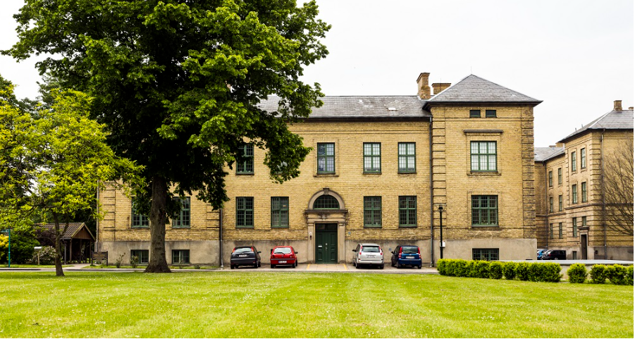

Slide 3
Non Governmental
Non Profit
One center in each municipality
In Middelfart 70 members
Funded ½ by the Government and ½ by the Municipality
94.000 Euro annually

Slide 4
Members
A voluntary social effort can be understood as an activity or effort aimed at increasing the welfare or care of individuals or groups, and as efforts aimed at solving welfare problems within the social area.
Voluntary Social Associations located in Middelfart

Slide 5
Members
Non profit
Non Governmental
Operates locally
Children, Families, Young People, Elderly, Refugees, Disabled, Illness, patient associations etc.
E.G. Red Cross, Danish Refugee Aid, Older Case, Self Help Groups, Mentoring

Slide 6
Promote volunteer work
Promote the visibility of volunteer social work
Show directions
Promoting networks
Volunteer Center Middelfart
Support and contribute to the development of the associations
Cooperation with the Municipality
Building bridges
Knowledge Center

Slide 7
Promoting Volunteer Work
Individuals who would like to become volunteers
NGO jobs
Volunteers jobs related to trade and business
Volunteer jobs related to the municipality

Slide 8
Showing Directions
Individuals who need help
Next of kin who seeks help and information
Employees in the Municipality

Slide 9
Promoting Network
Between the associations themselves
Between the associations and the municipality

Slide 10
Building Bridges
Associations and trade/business/culture etc.
Associations and the municipality
Individuals and the associations

Slide 11
Knowledge Center
Knowledge, expertise and know how regarding voluntarism - and keeping up to date with the newest trends

Slide 12
Cooperation with the Municipality
Council for the vulnerables
Competence catalog
Information about voluntarism and the possibilities to get help and join different communities with the voluntary world

Slide 13
Support to and development of the associations
Workshops
Consultant help (strategy, funding, conflict, management)
PR
Meeting and office facilities
Recruitment of volunteers

Slide 14
PR - promoting activities and volunteer jobs
Facebook
Newspaper
Events
Speeches
Workshops
www.socialkompas.dk

Slide 15
www.socialkompas.dk
=
Inclusion, participation and development of the local community
www.socialkompas.dk
Digital platform
Visibility of voluntary social activities and unvisited offers from the municipality
Activities for people who need help, information or social activities
Critical infrastructure in regards to vira, refugees and other catastrophes/emergencies

Slide 16
Thank you :-)

